Slide 1
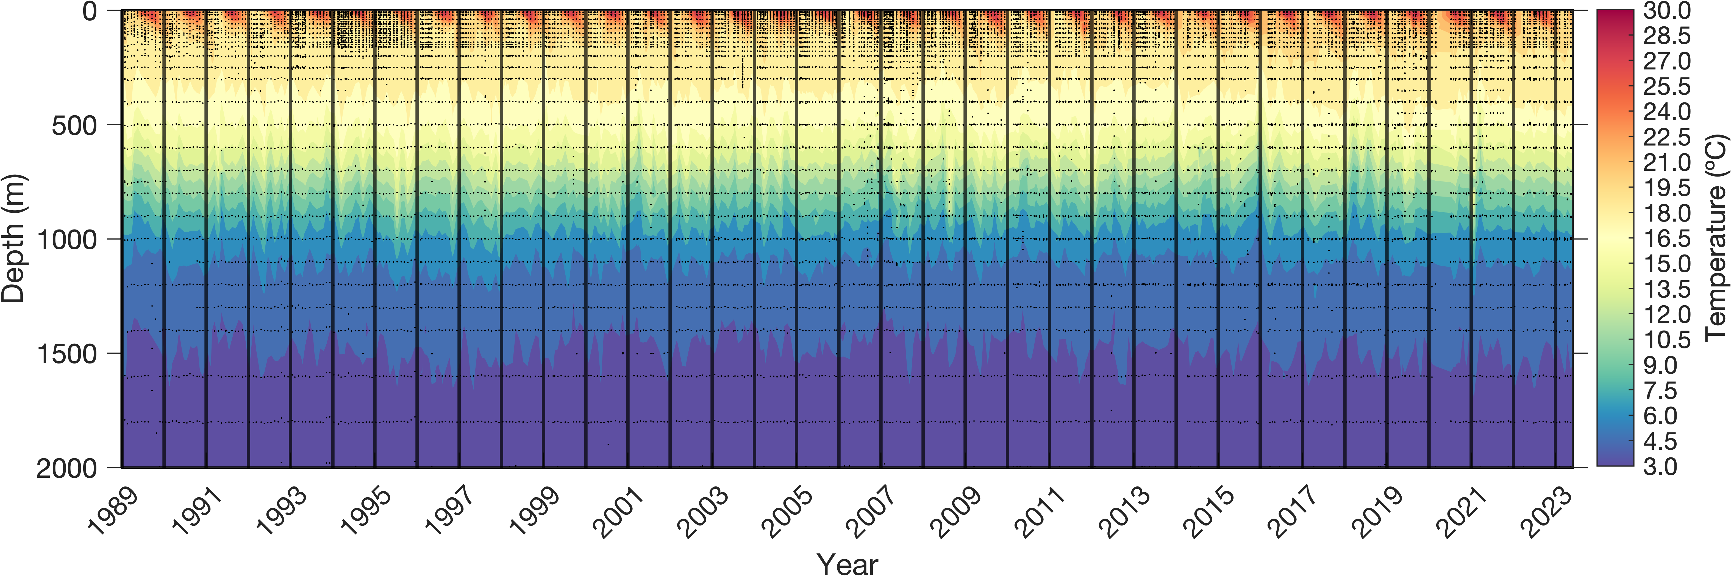
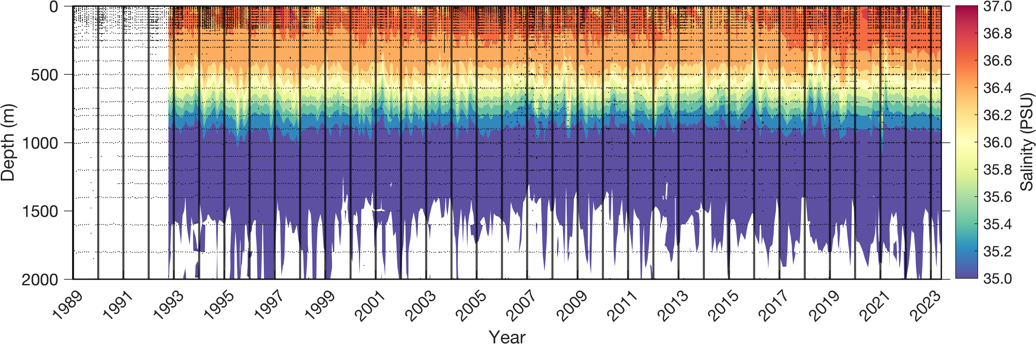
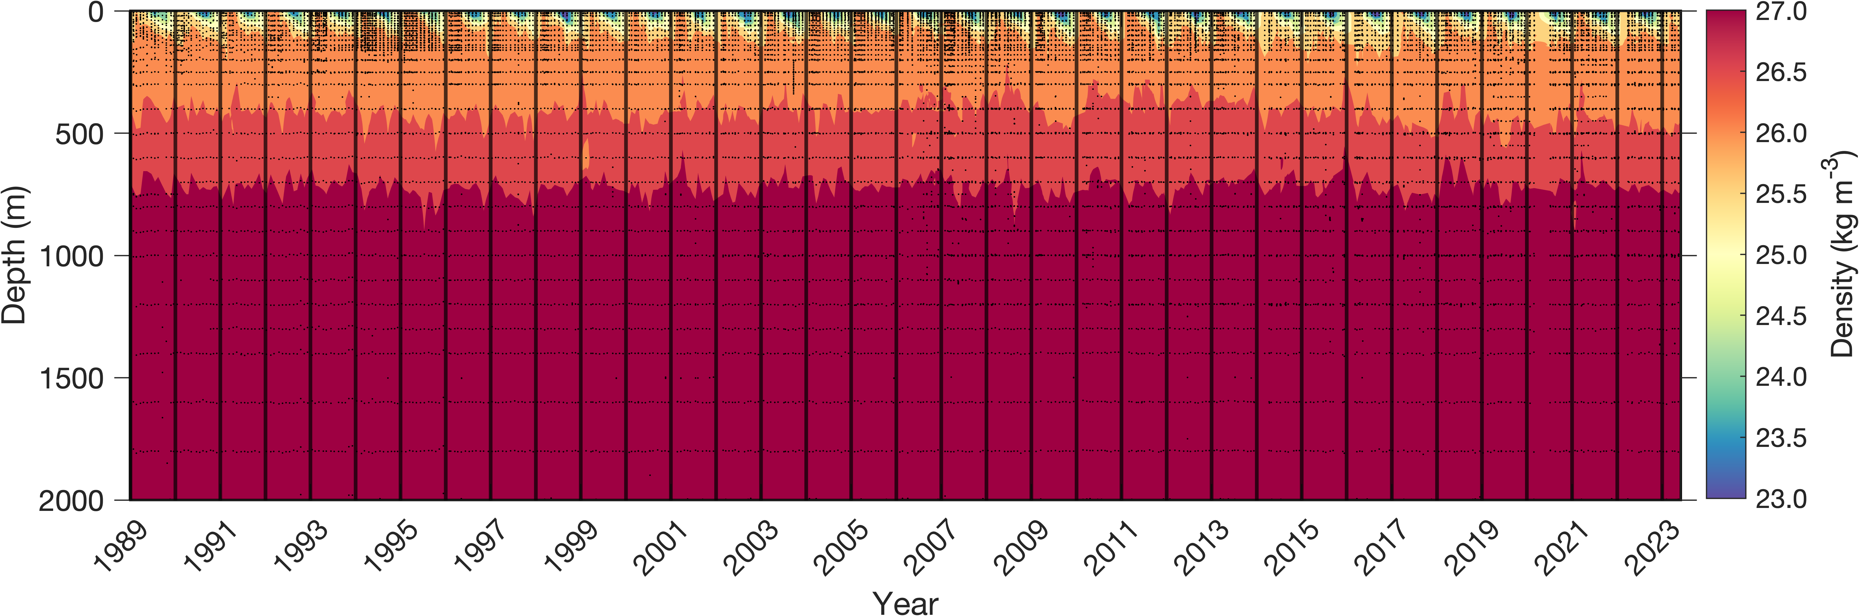
Physical variables
Hurricane Dean: 1989/08/06
Hurricane Felix: 1995/08/15
Hurricane Fabian: 2003/09/05
Hurricane Florence: 2006/09/11
Hurricane Igor: 2010/09/19
Hurricane Fay: 2014/10/12
Hurricane Gonzalo: 2014/10/17
Hurricane Joaquin: 2015/10/4
Hurricane Nicole: 2016/10/13
Hurricane Humberto: 2019/09/18
Hurricane Paulette: 2020/09/14
Hurricane Fiona: 2022/09/23

Slide 2
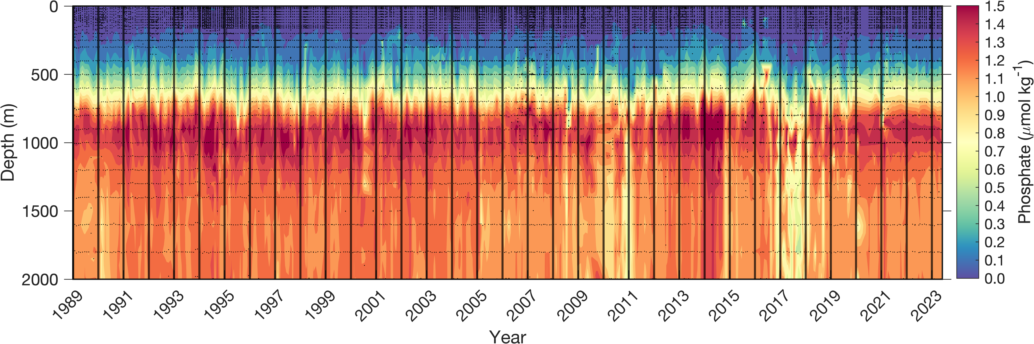
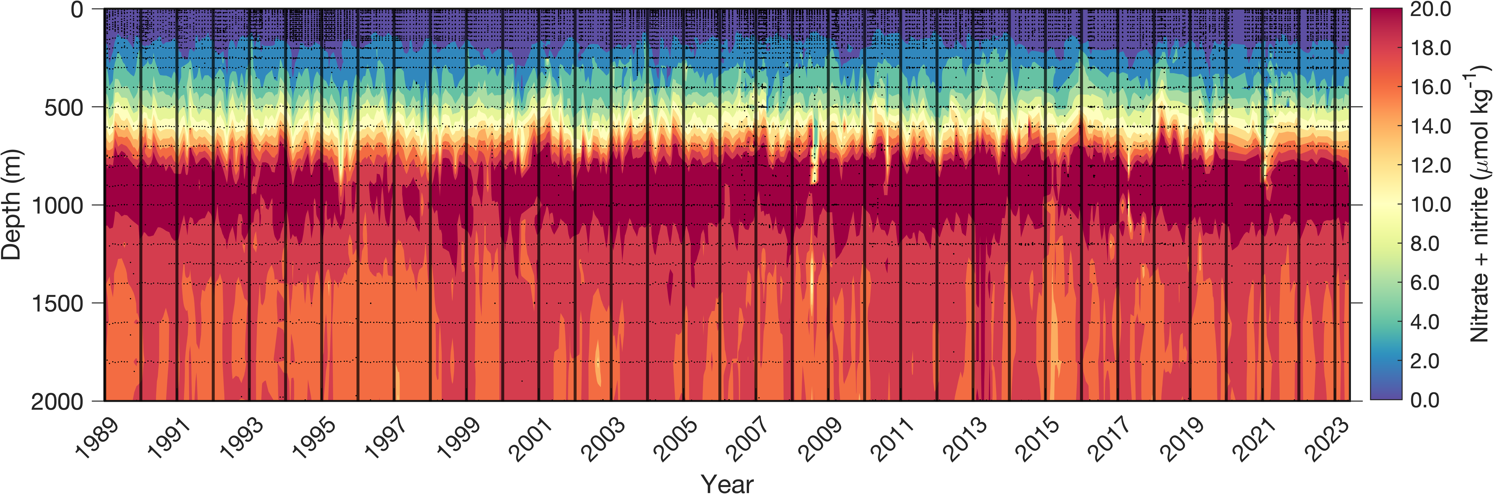
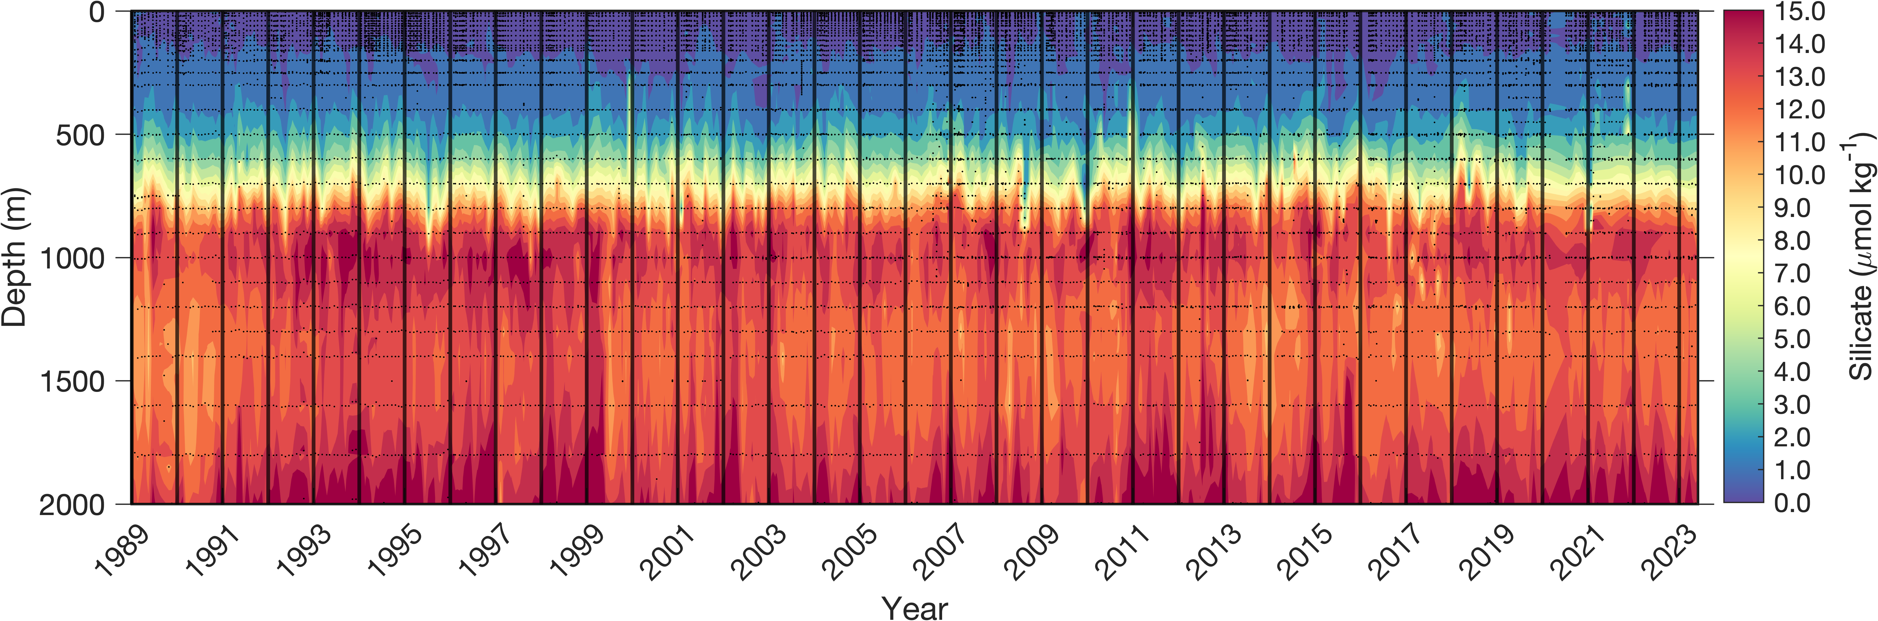
Nutrient variables
Hurricane Dean: 1989/08/06
Hurricane Felix: 1995/08/15
Hurricane Fabian: 2003/09/05
Hurricane Florence: 2006/09/11
Hurricane Igor: 2010/09/19
Hurricane Fay: 2014/10/12
Hurricane Gonzalo: 2014/10/17
Hurricane Joaquin: 2015/10/4
Hurricane Nicole: 2016/10/13
Hurricane Humberto: 2019/09/18
Hurricane Paulette: 2020/09/14
Hurricane Fiona: 2022/09/23

Slide 3
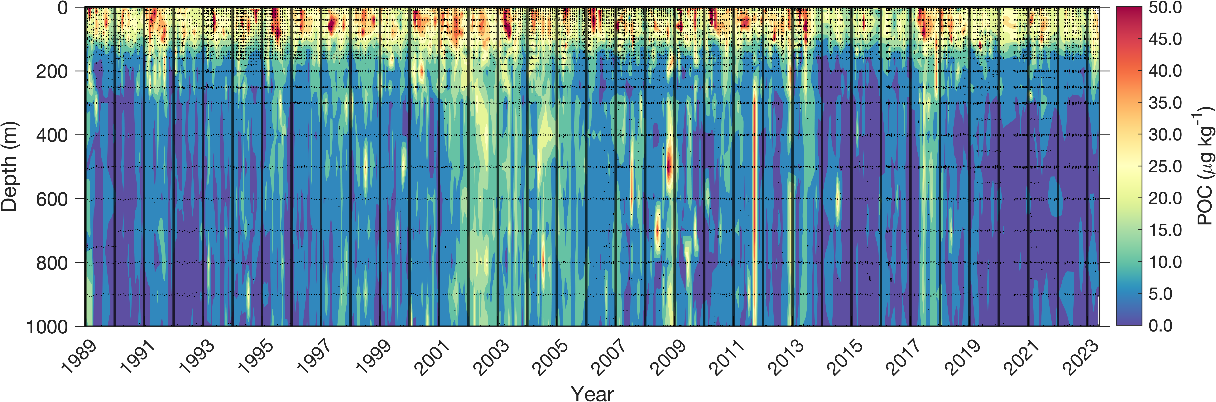
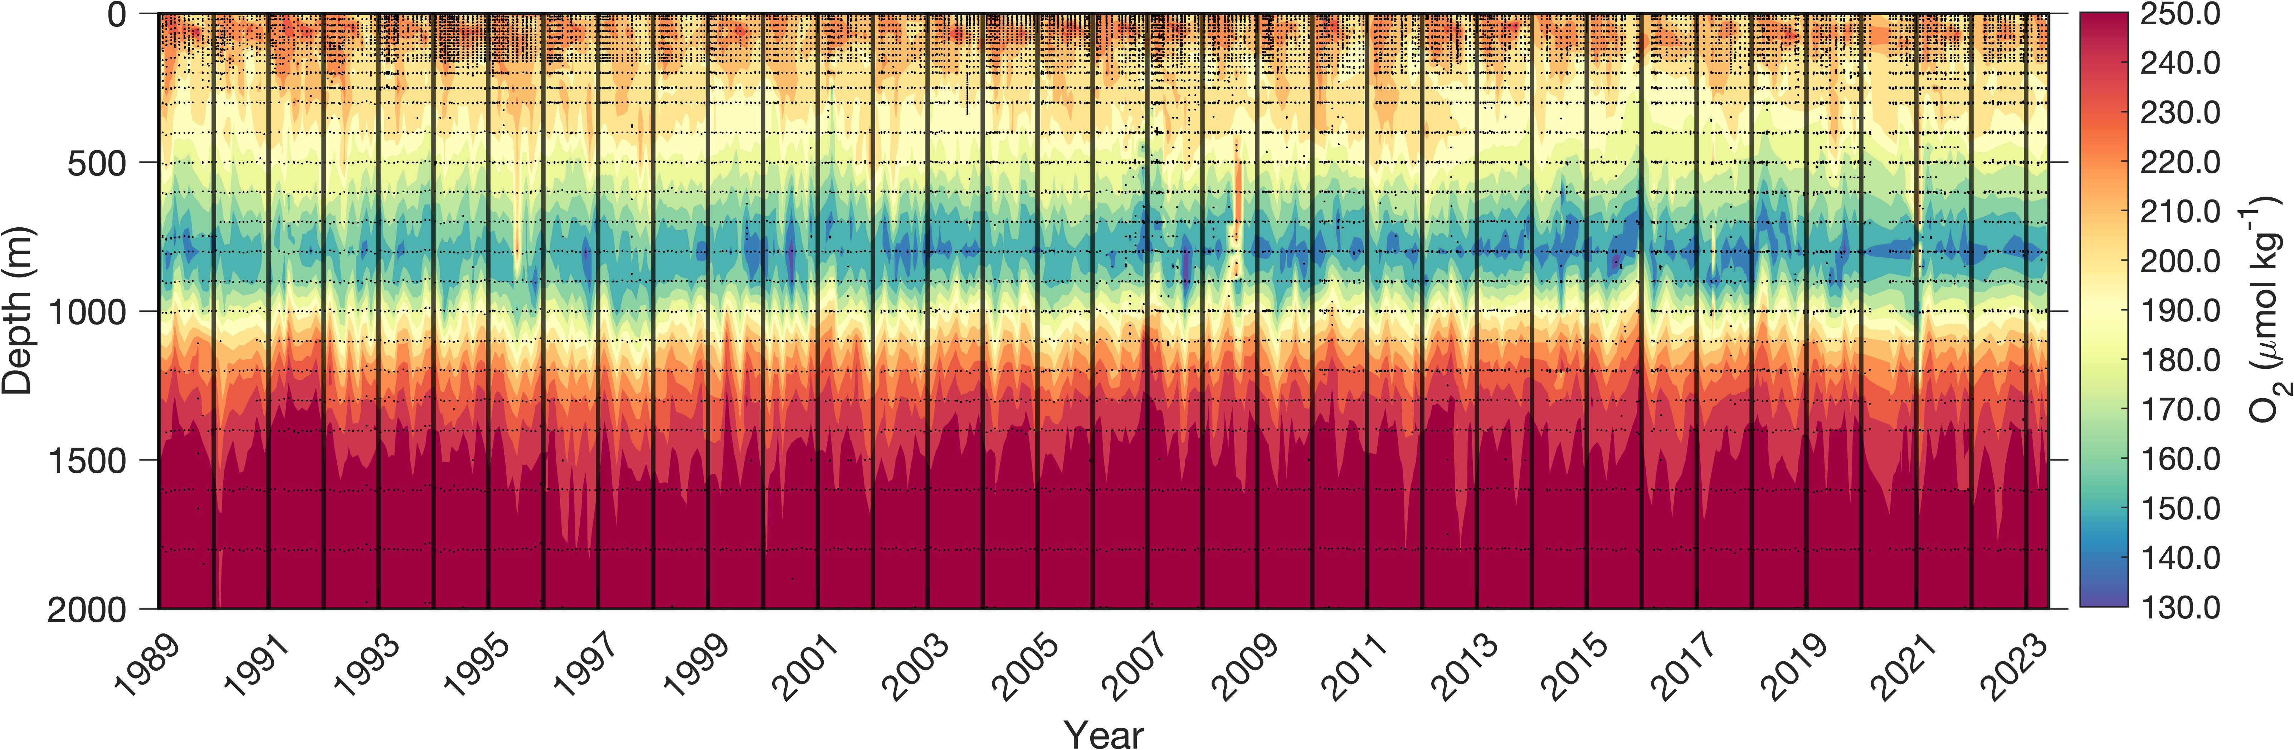
Biological activity variables

Slide 4
Primary producer variables
Eukariotic phytoplankton
Prymnesophytes (aka, coccolithophores) – 19’Hex
Pelagophytes (mostly picophytoplankton) – 19’But
Diatoms – fucoxanthin
Dinoflagellates – peridinin
Prokariotic phytoplankton
Cyanobacteria (Synechococcus) – zeaxanthin
Prochlorophytes (Prochlorococcus)

Slide 5
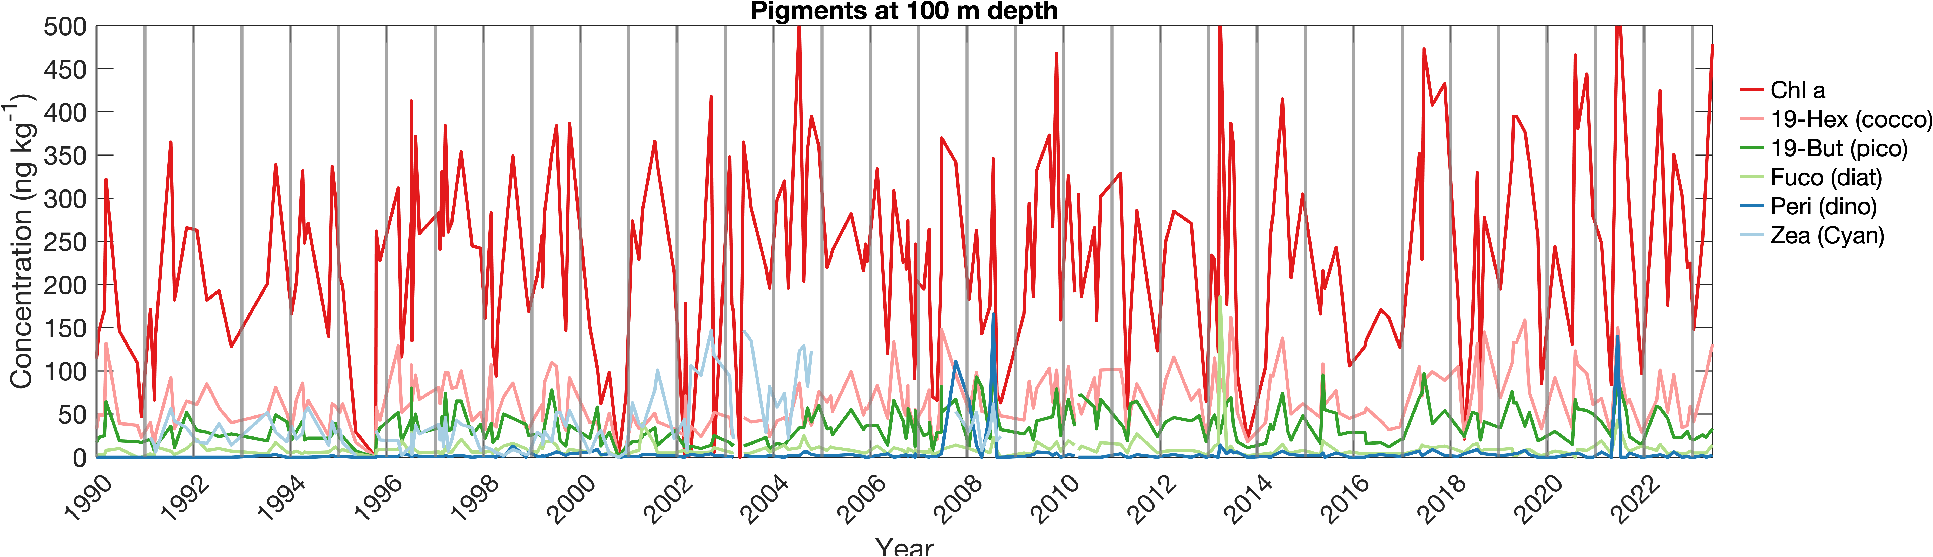

Slide 6
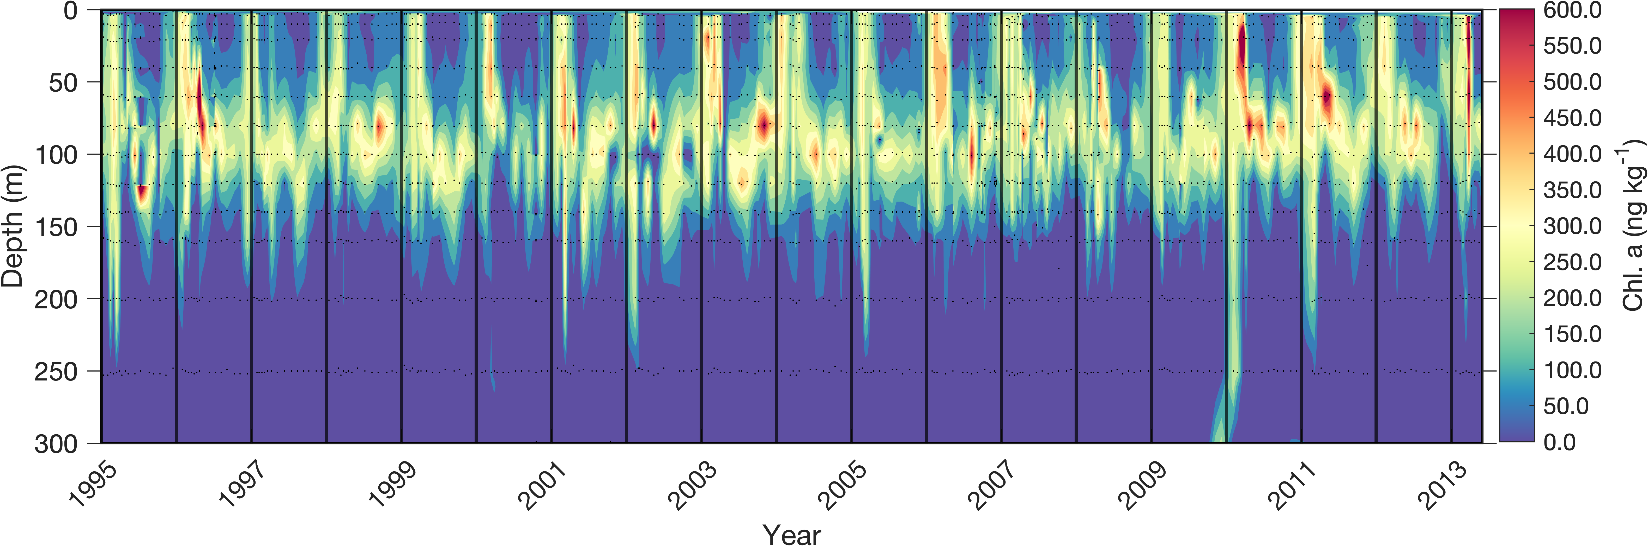
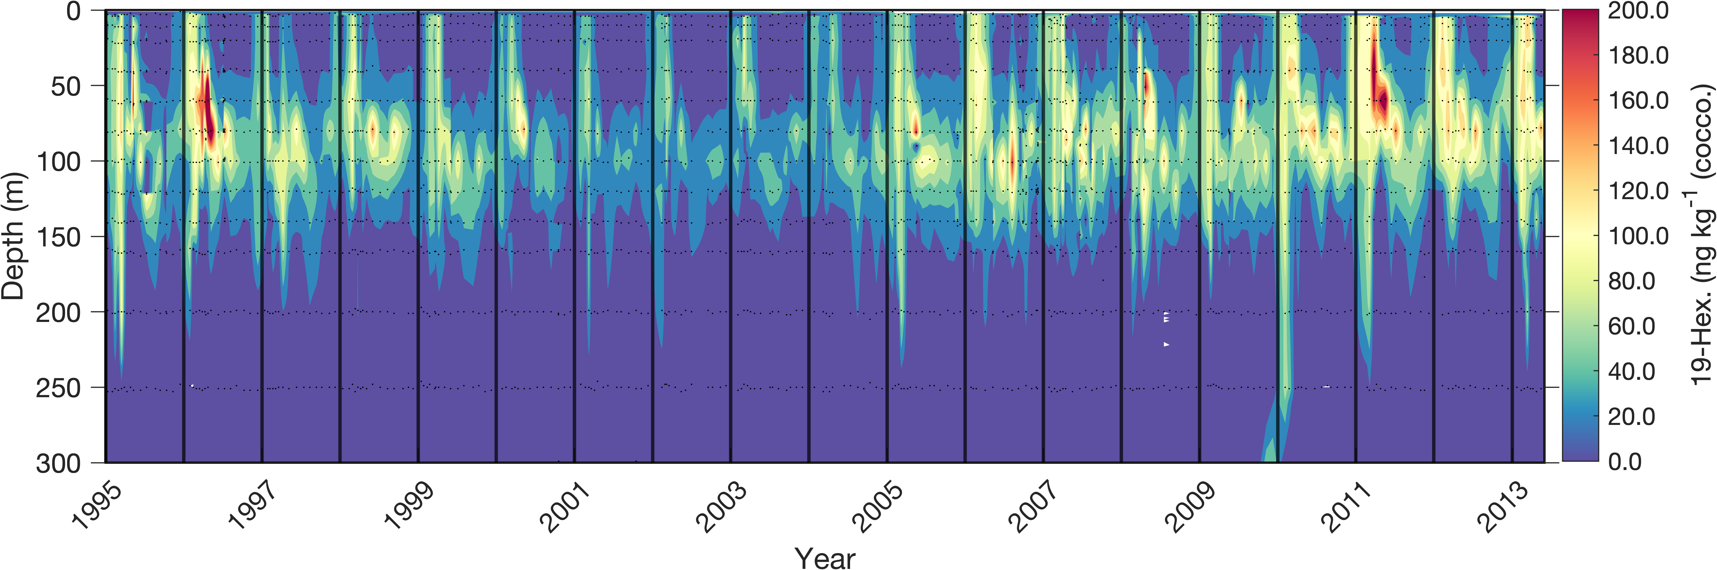
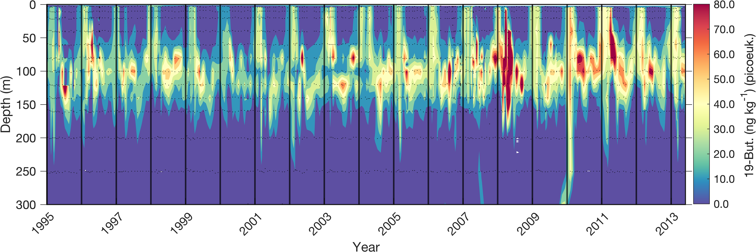
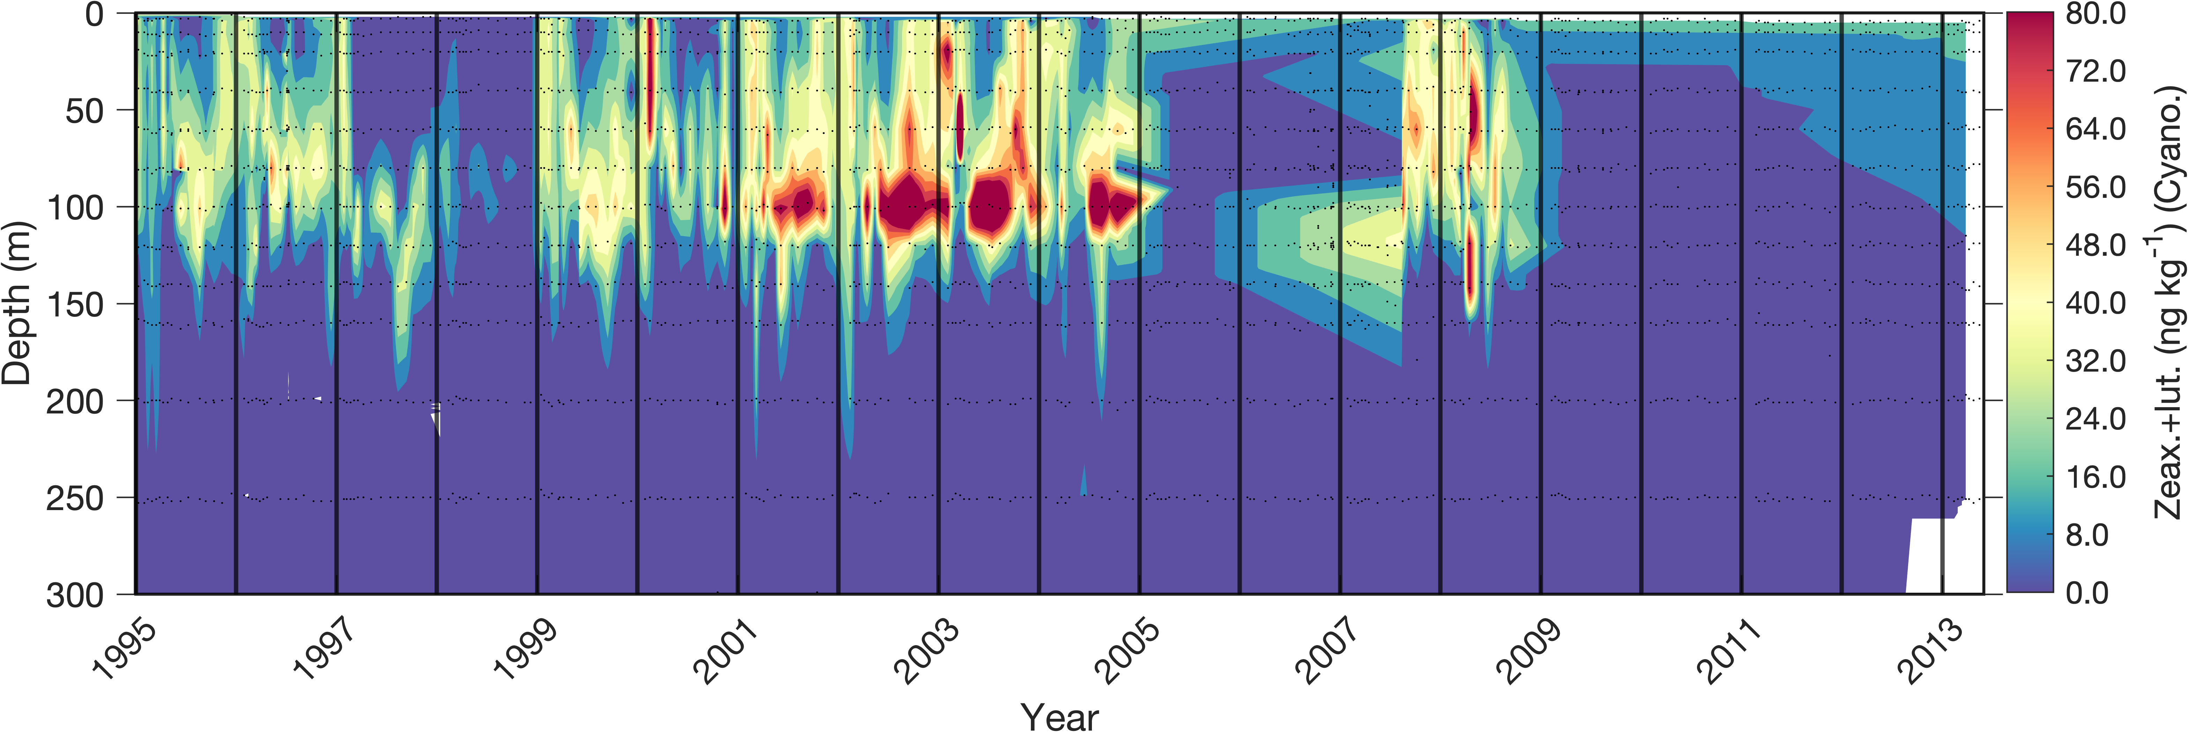
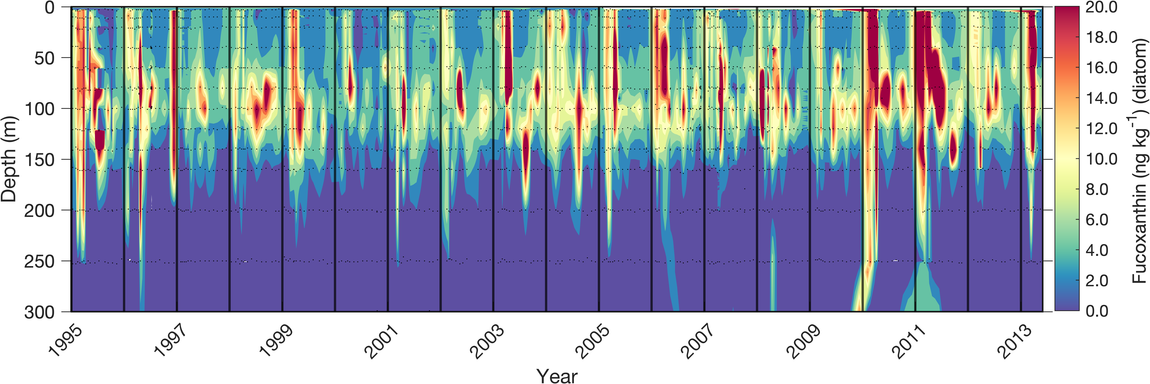
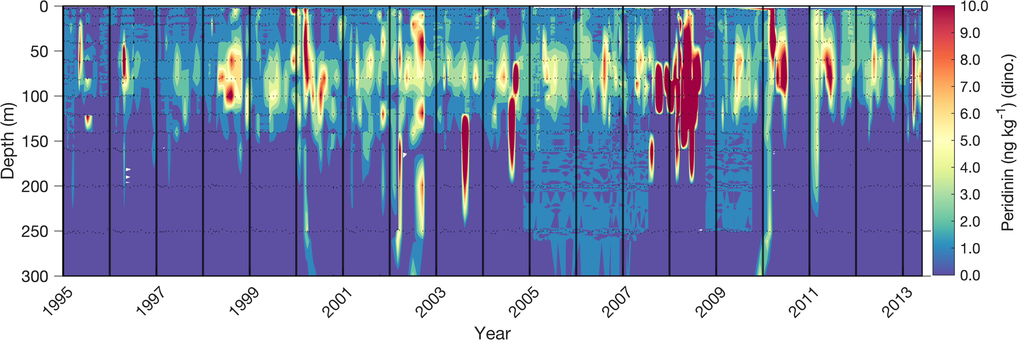
Primary producer variables

Slide 7
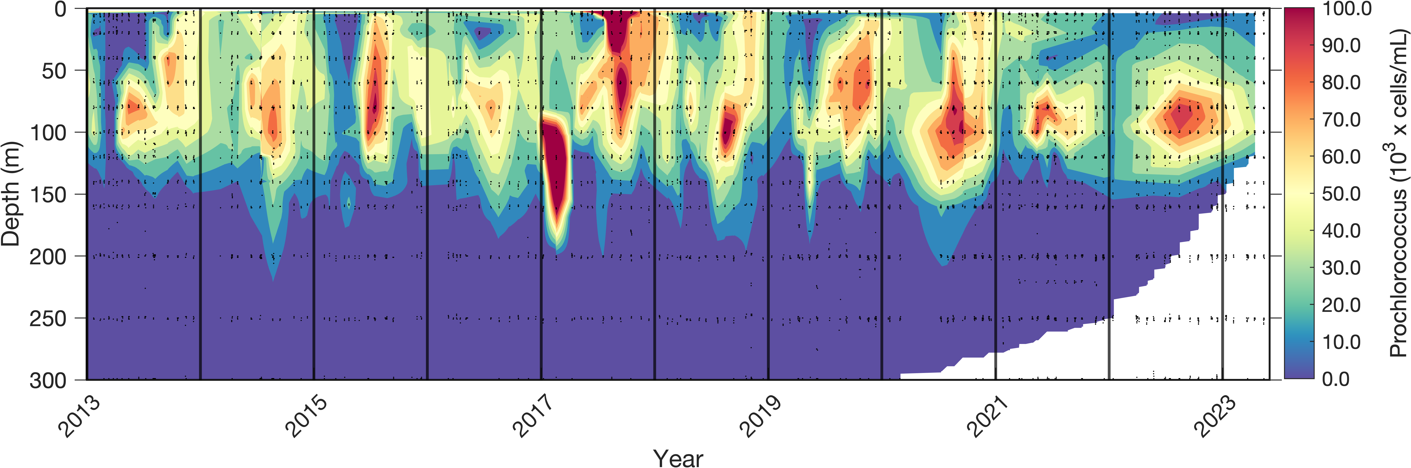
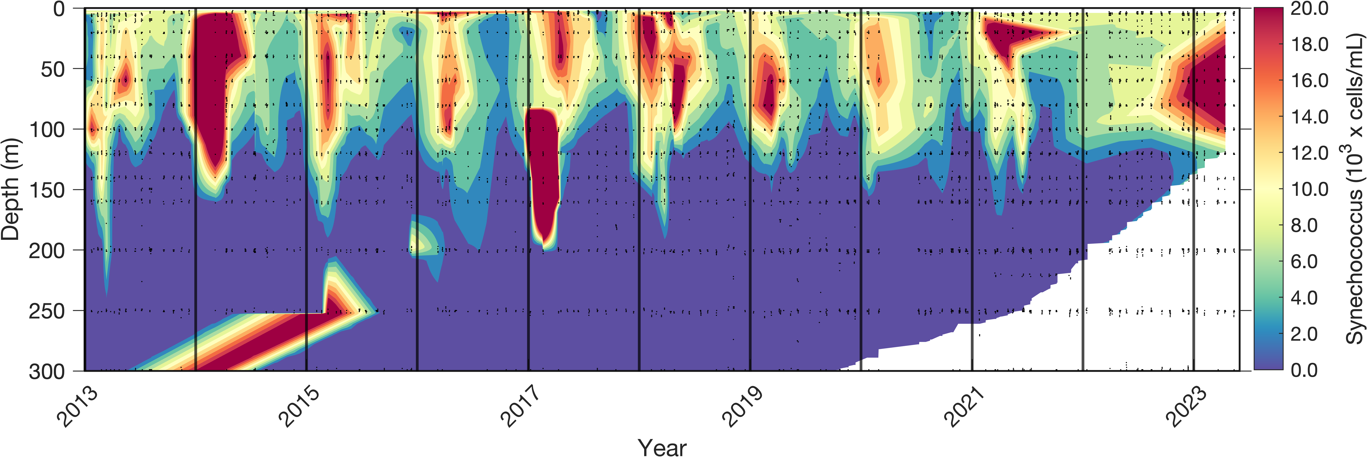
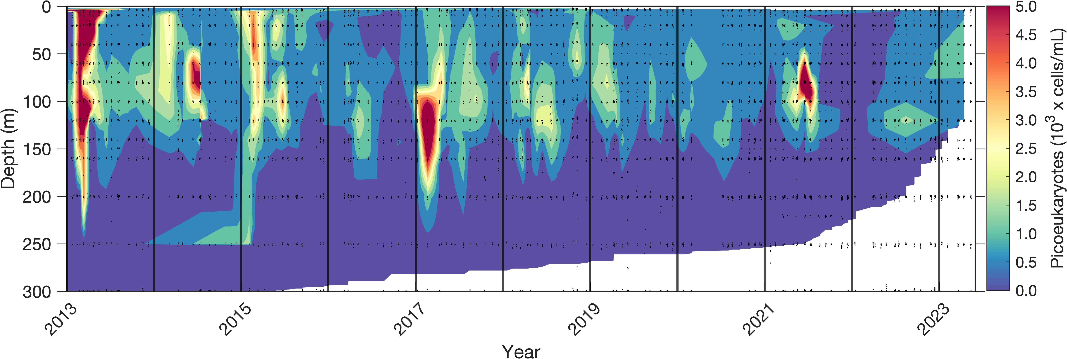
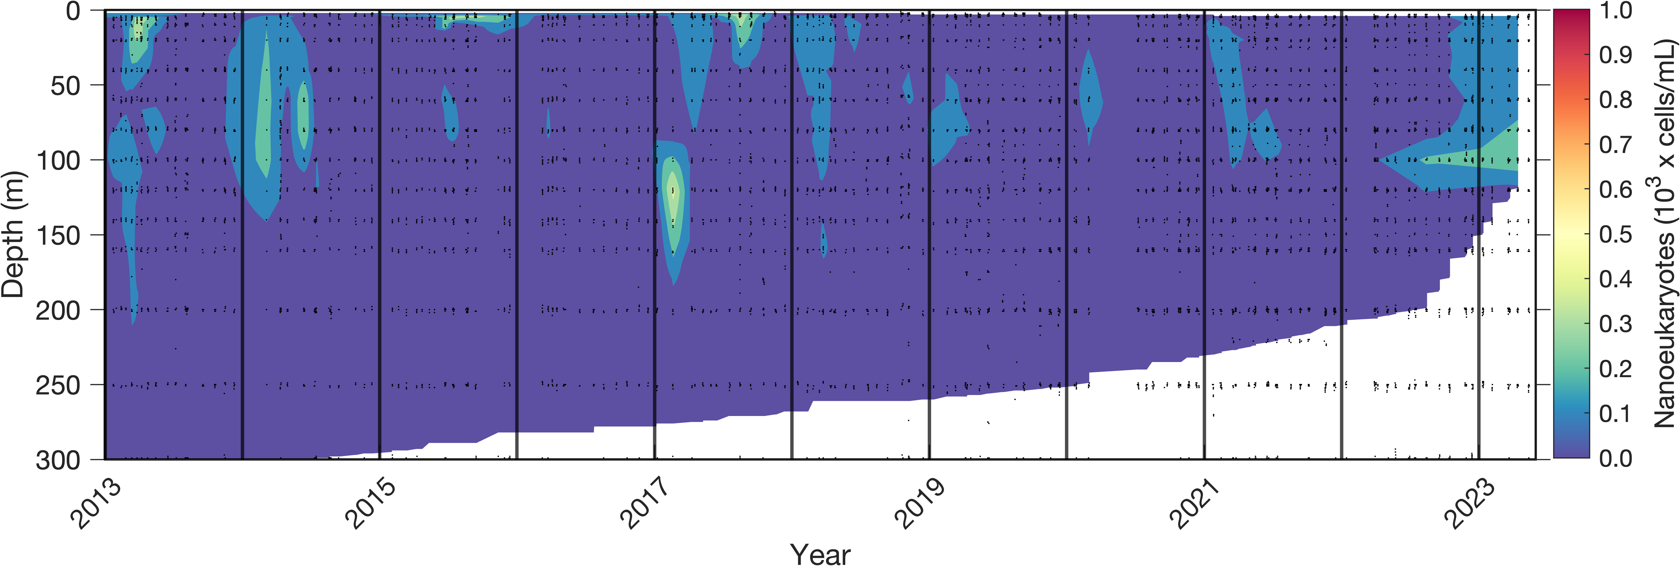
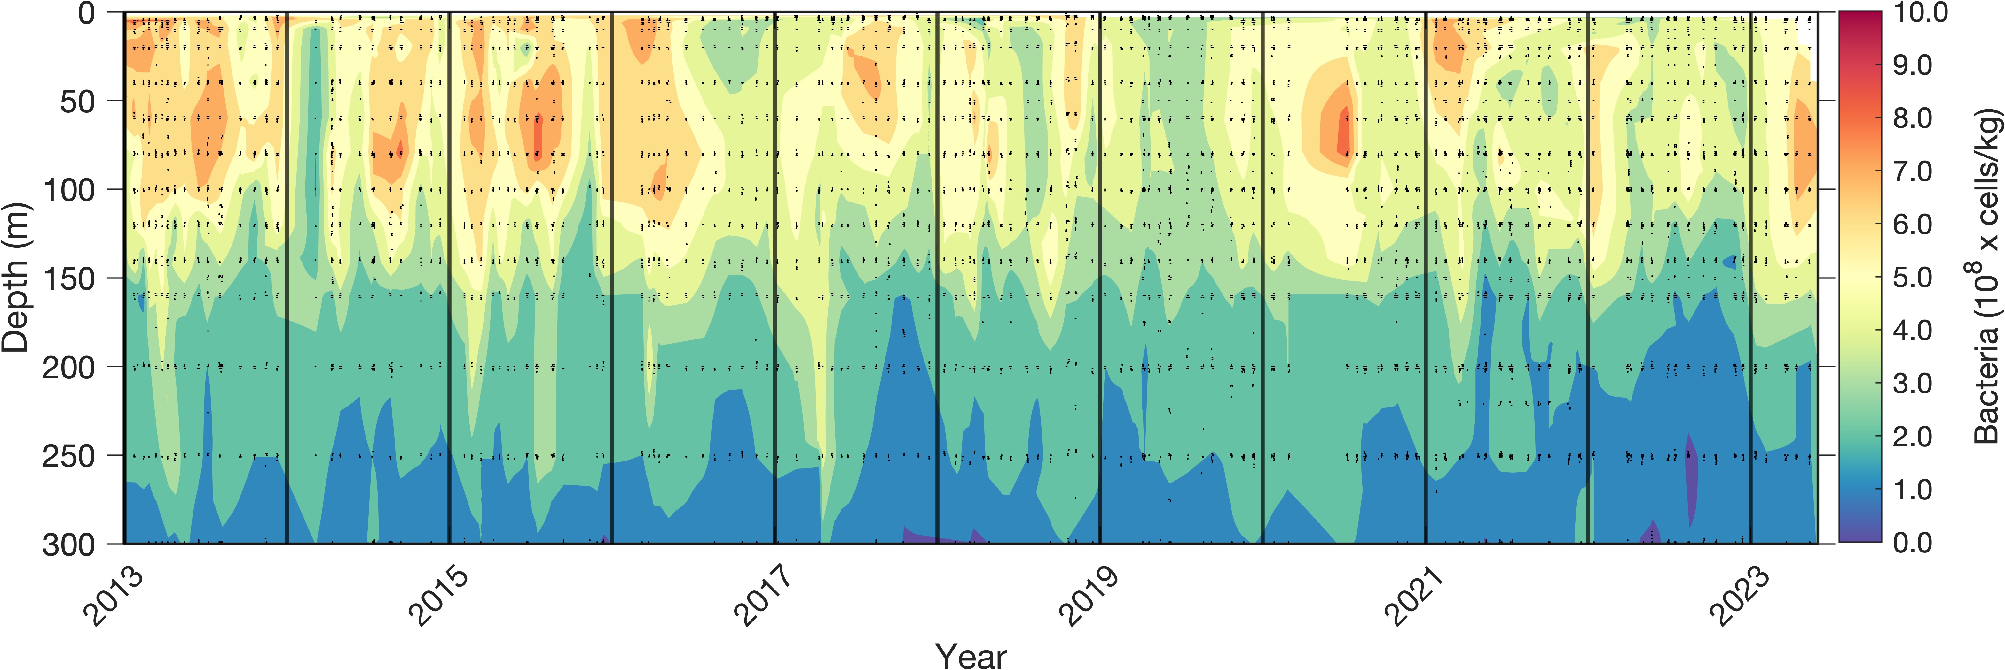
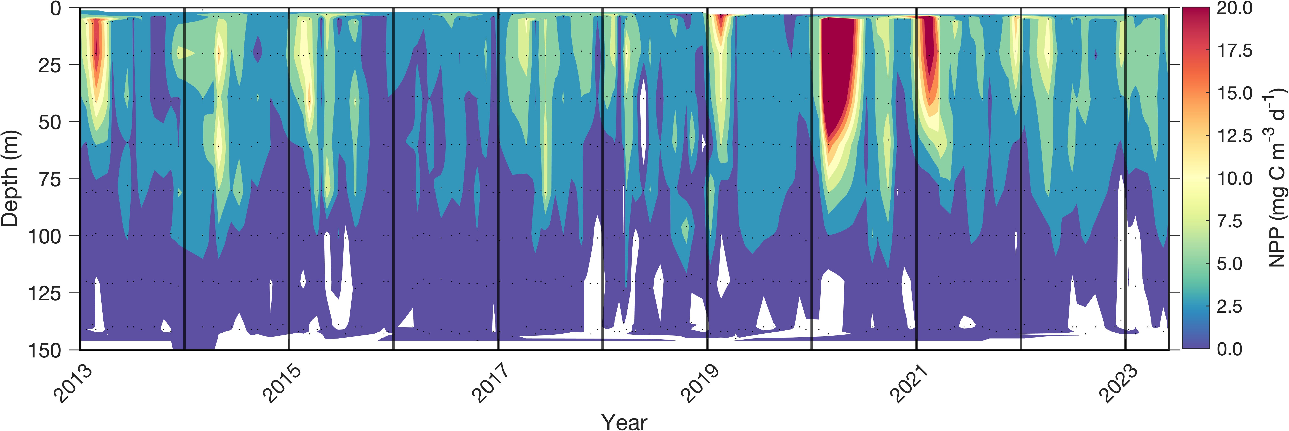
Primary producer variables

Slide 8
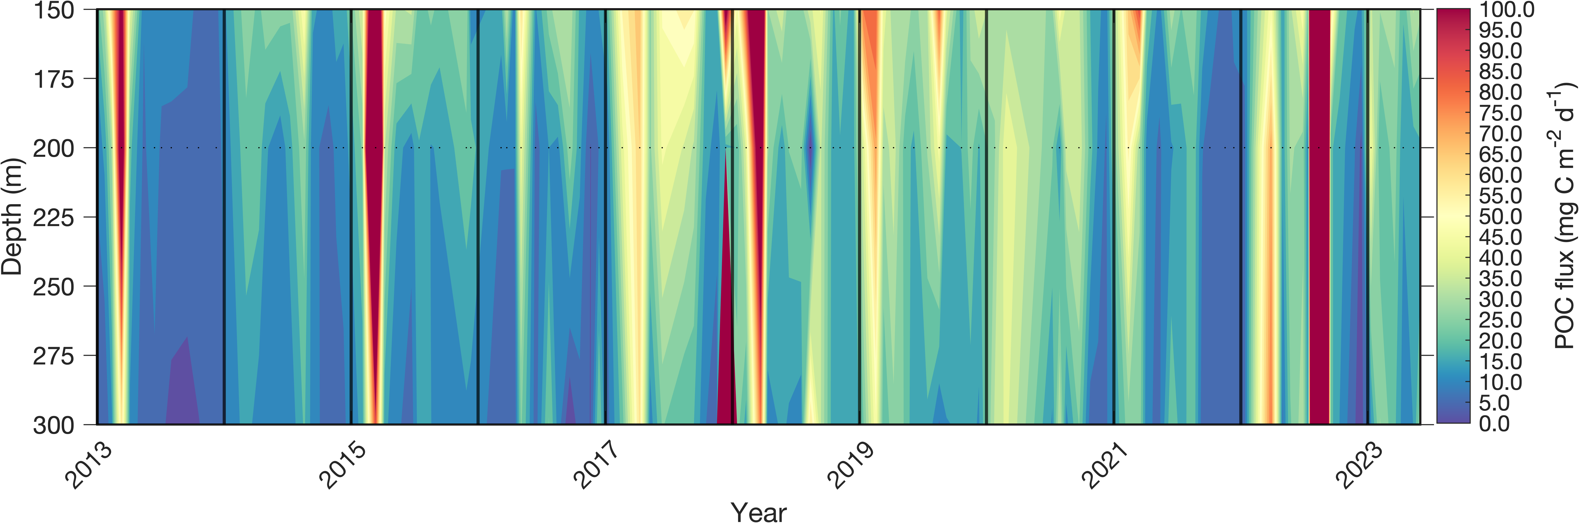
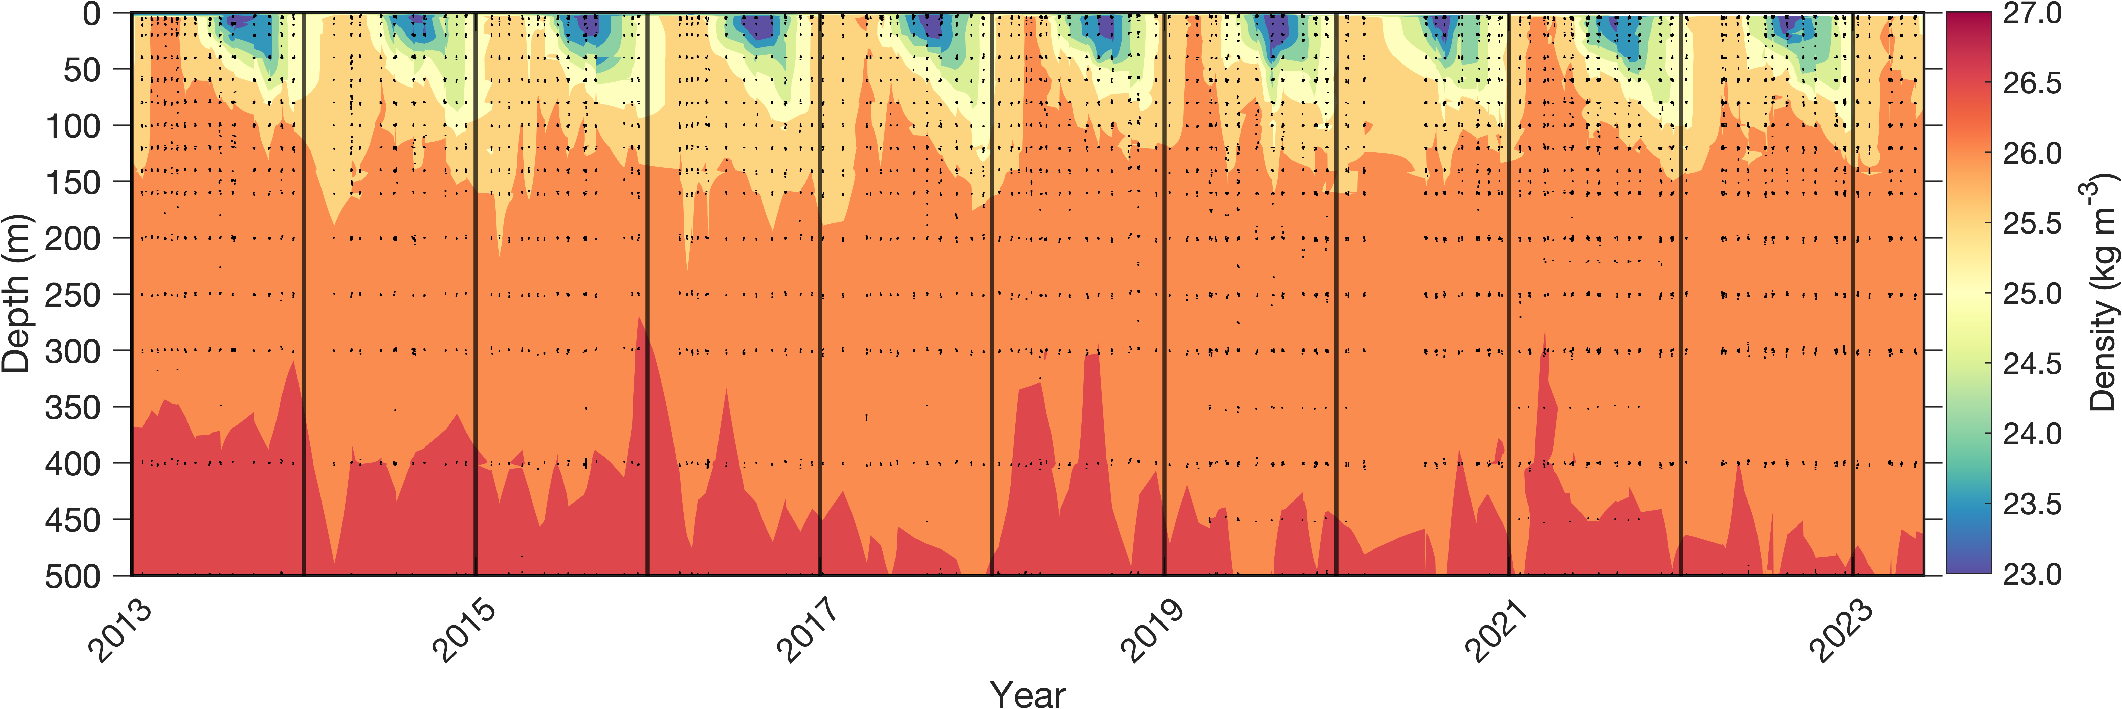
Flux variables
(BATS)

Slide 9
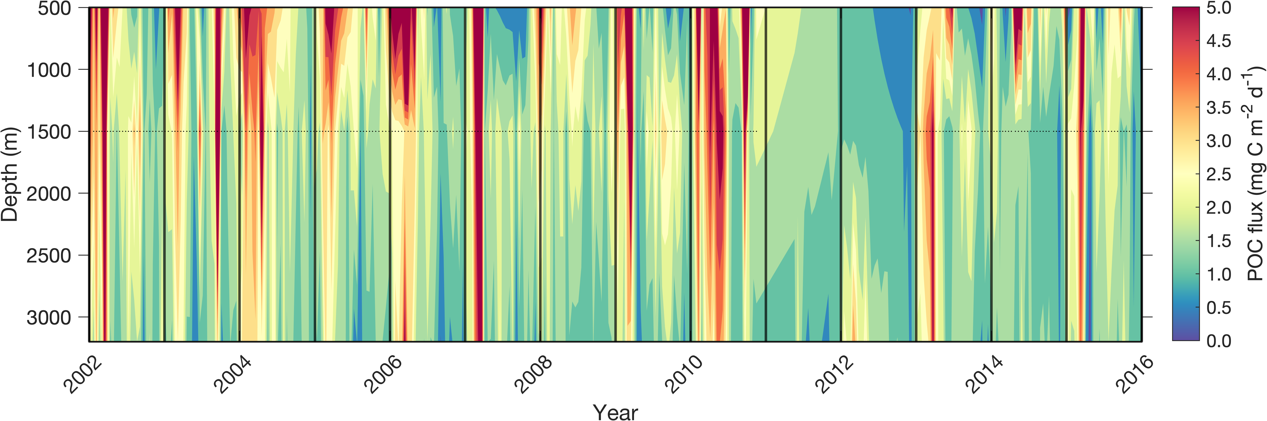
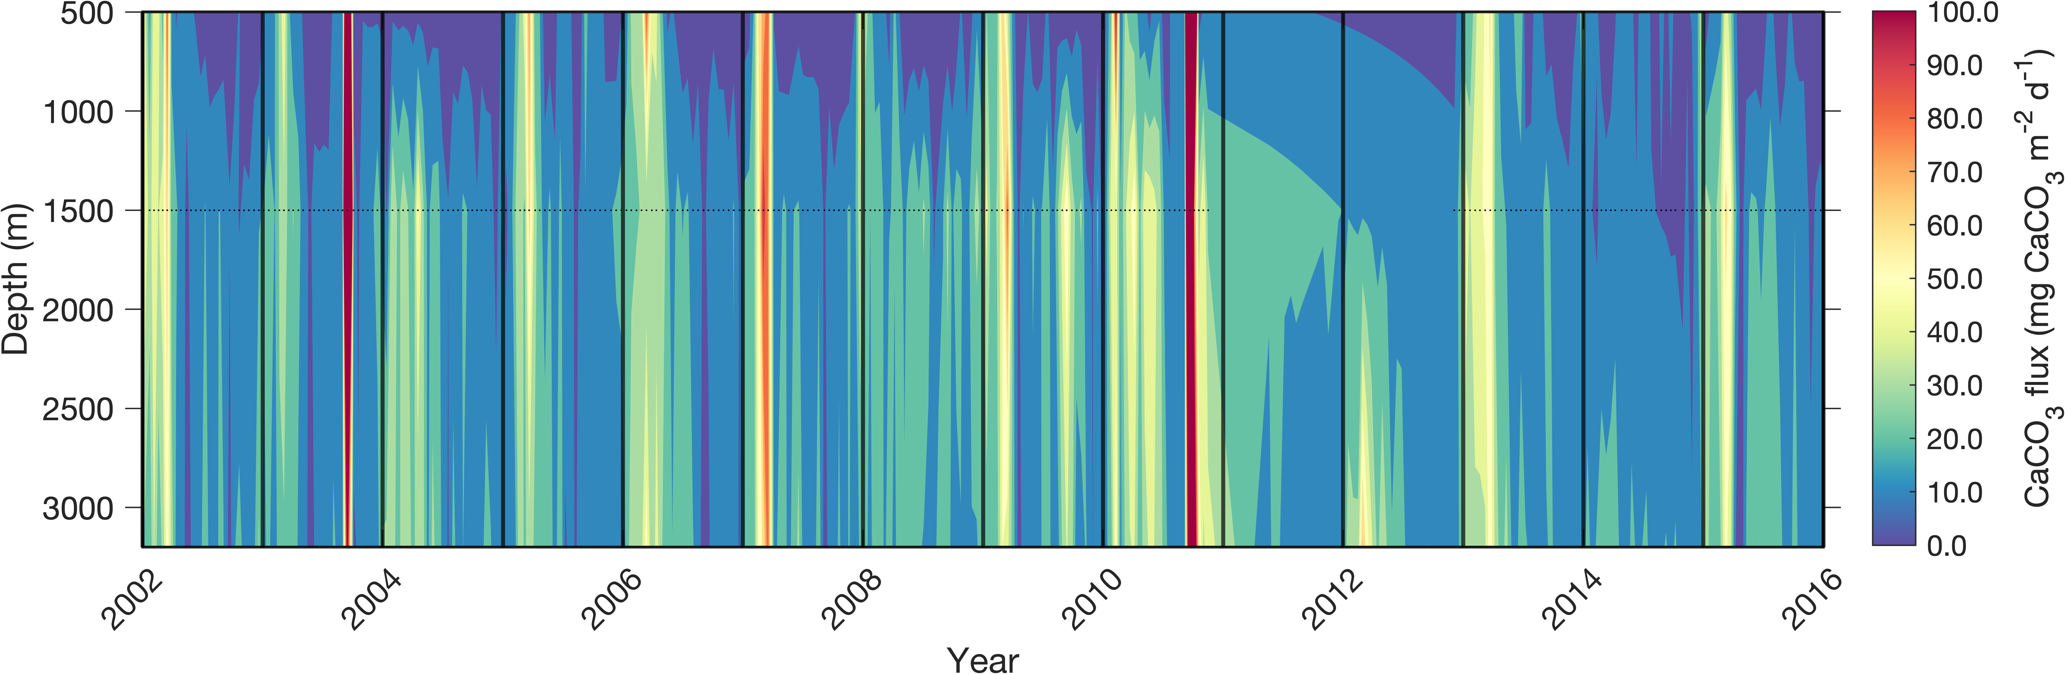
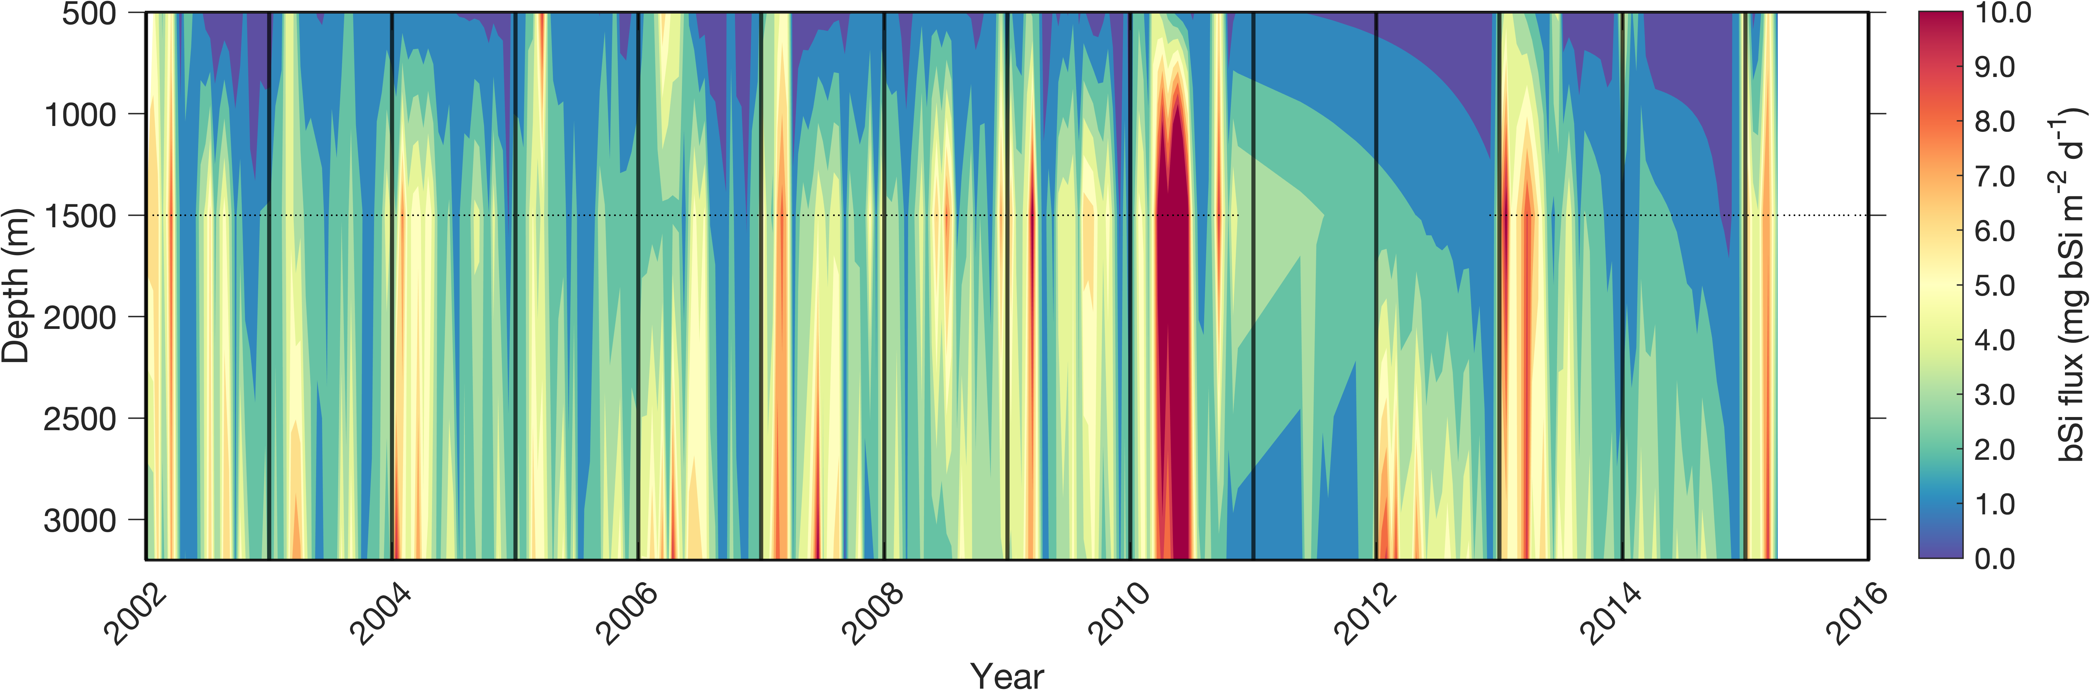
Flux variables
(OFP)

Slide 10
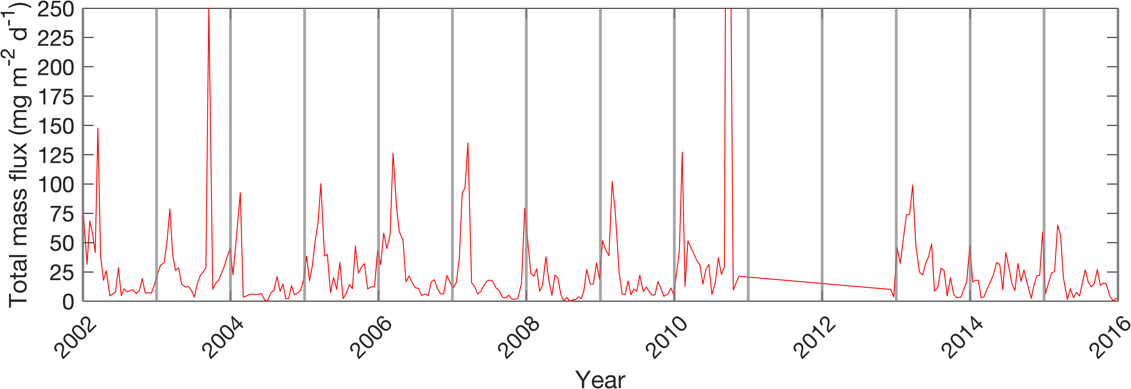
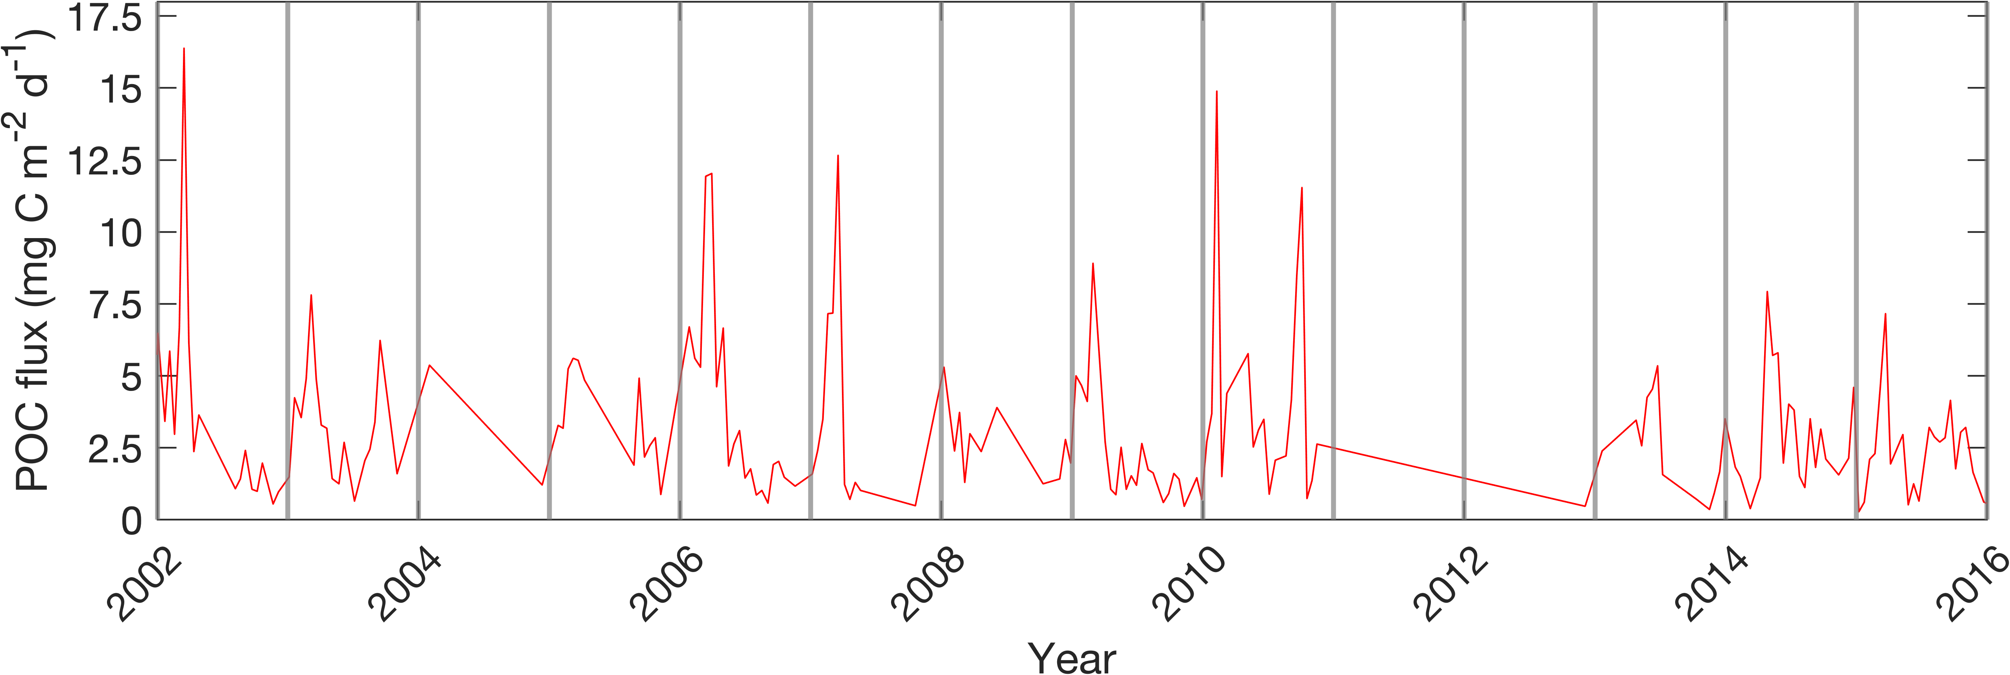
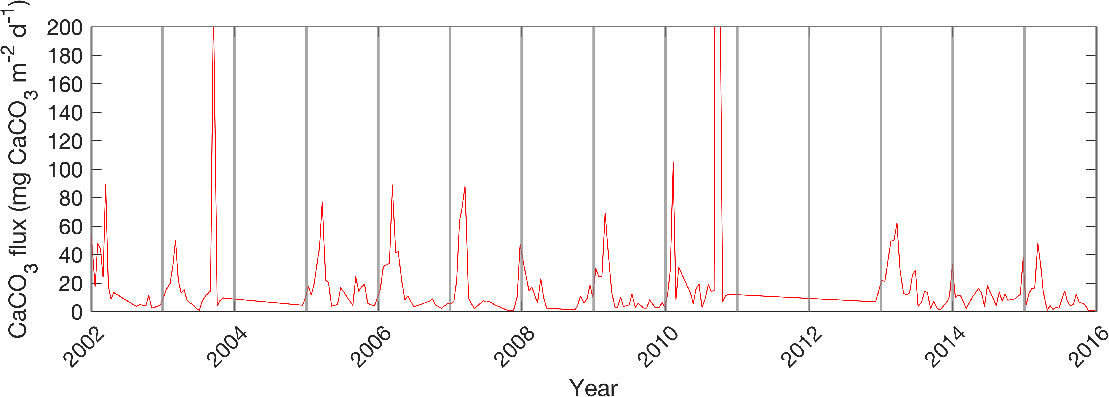
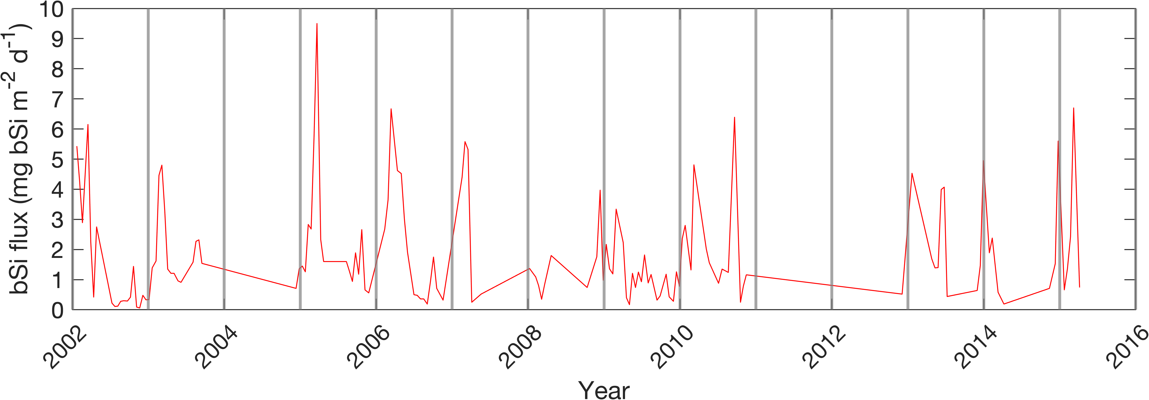
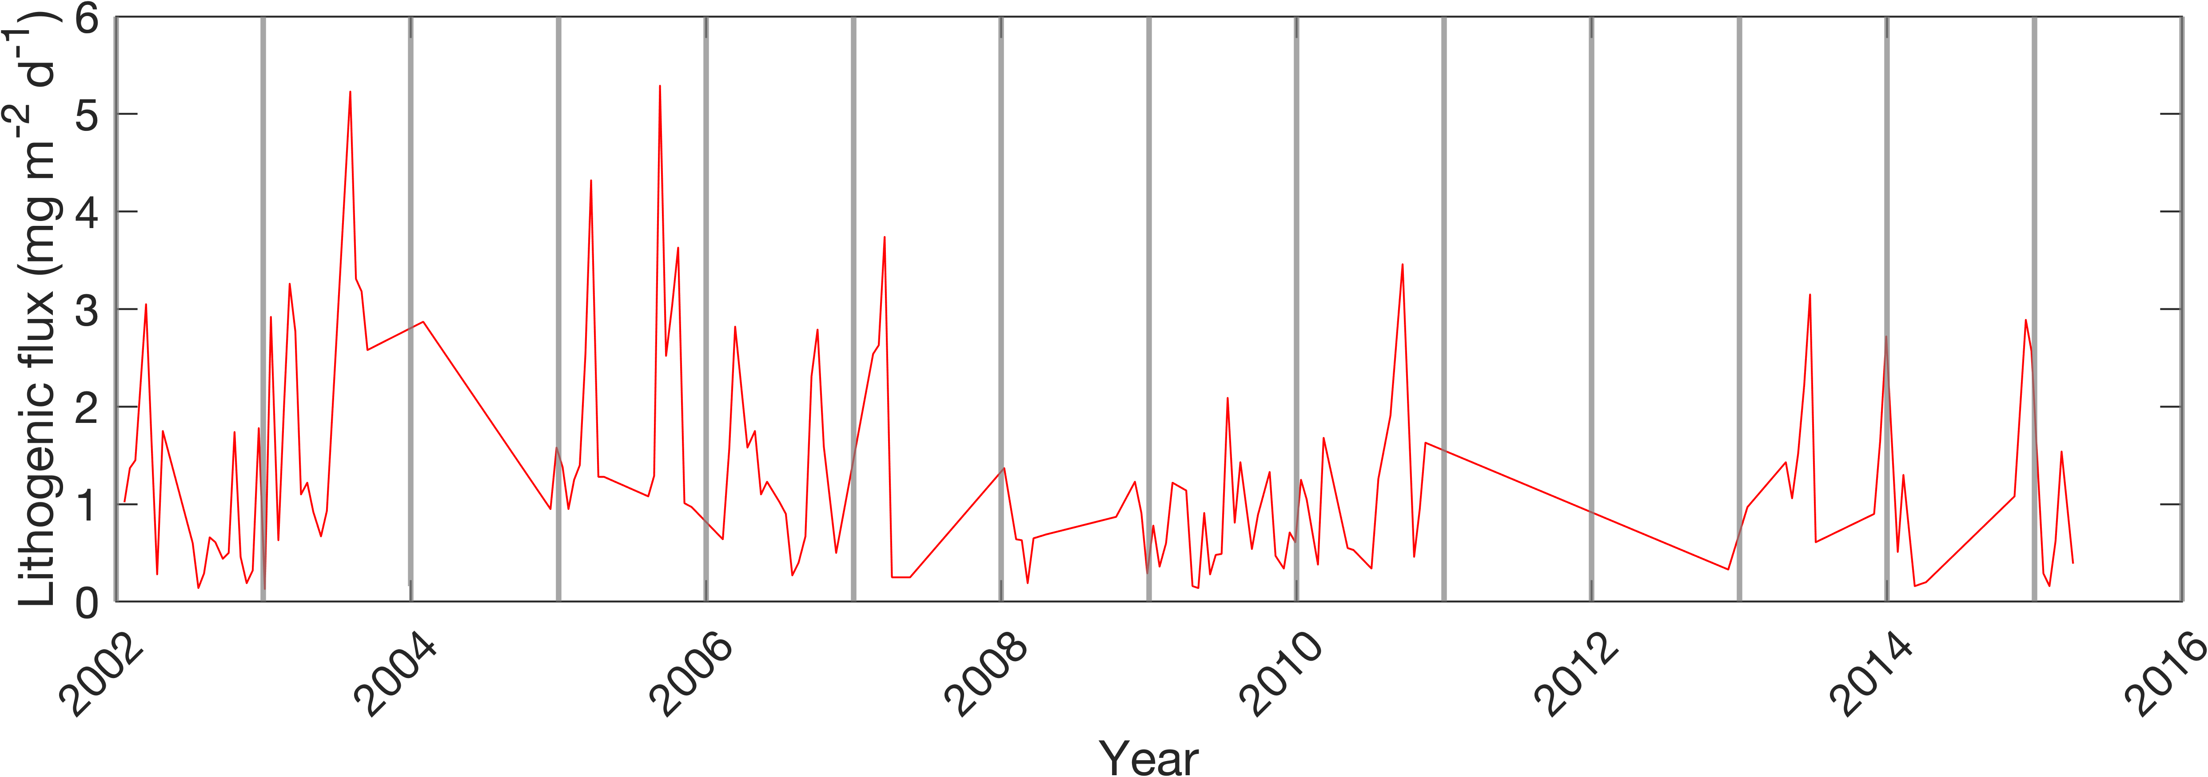
Increased mass flux events dominated by CaCO3 flux

Slide 11
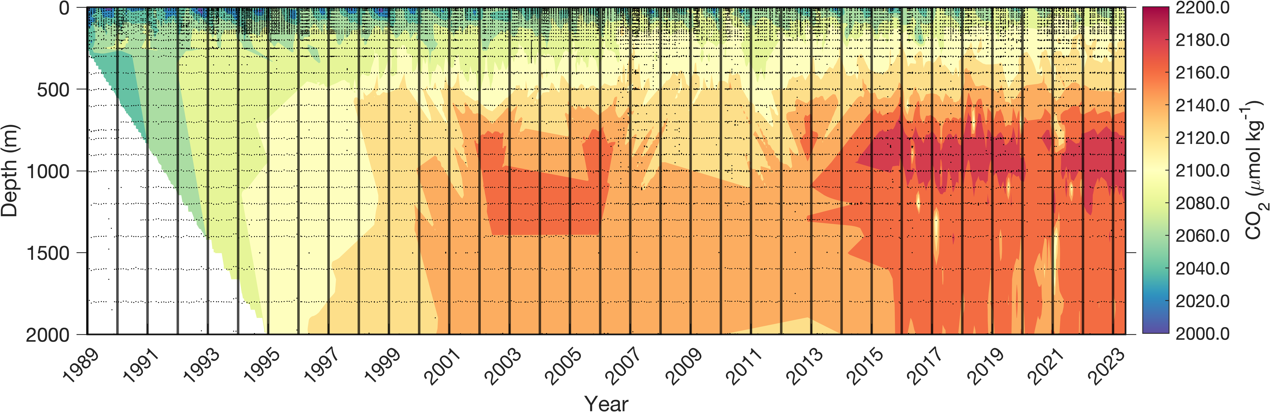
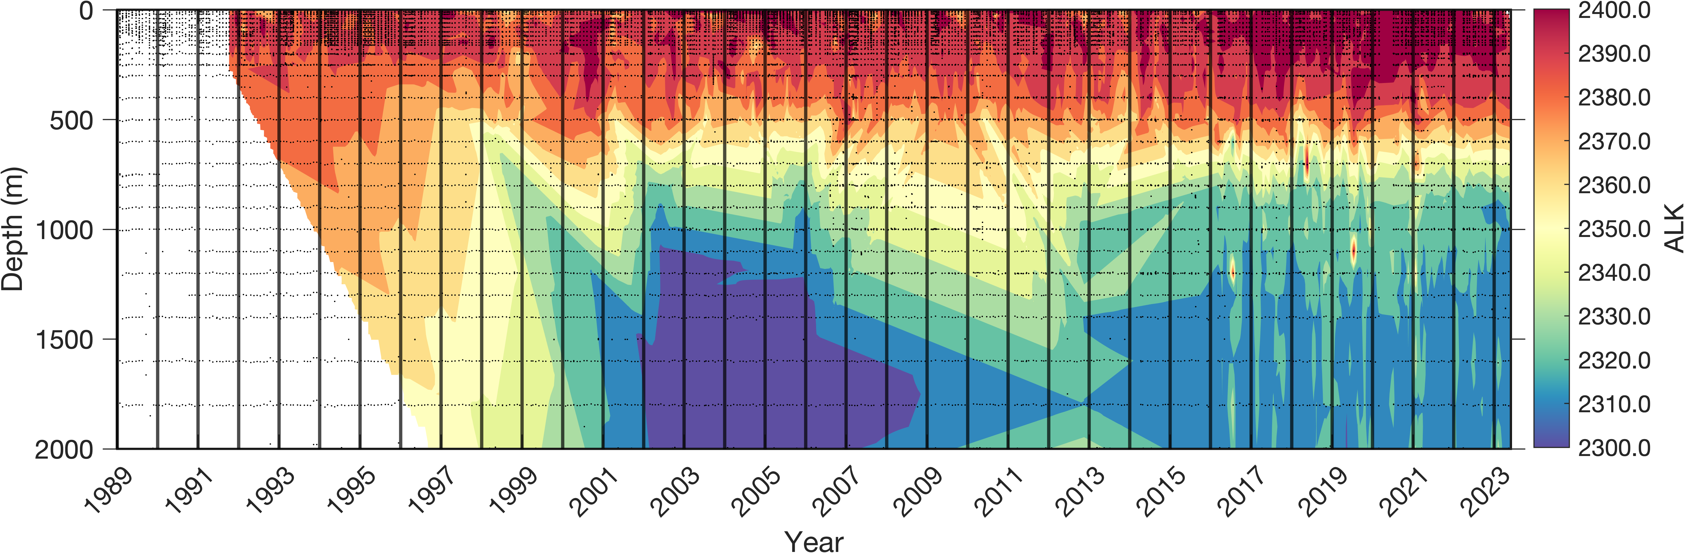
Carbonate system variables

